Slide 1
Get Data
<number> / 6

Slide 2
Few Definitions
Transmission protocols
  UDP
    UDP stands for user datagram protocol and is an unreliable connectionless transmission protocol. The term connectionless means that the sender is not aware of the receiver(s): it is sending out data without knowing if the intended recipient is there as there is no handshake before sending data.
    UDP is like sending out a letter in the post with a standard stamp; you won't get a confirmation that's its arrived you just hope it does.
  TCP
    TCP stands for transmission control protocol and is a reliable connection-based transmission protocol. As TCP is connection-based the sender is fully aware of the state of the intended recipients. A handshake must take place and a connection formed between sender and receiver before any data is sent.
    TCP is like sending a letter using a recorded postal service, you get an acknowledgement that the letter has arrived and if it does not you can send it again.
<number> / 6

Slide 3
Few Definitions
Communication Types
  Unicast
    Unicast is a one-to one connection between the client and the server (In most cases the server is the video encoder). Unicast uses IP delivery methods such as Transmission Control Protocol (TCP) and User Datagram Protocol (UDP). The client has a direct relationship to the server.
  Multicast
    Multicast is a true broadcast. There is no direct relationship between the clients and server. But this is not for everyone, if your encoder is connected to an un-configured Ethernet switch and sends out a multicast message it will broadcast this message out on all ports and flood the entire network with your stream. It will flood the network and degrade its performance
<number> / 6

Slide 4
Packet Loss
  Packet loss occurs when one or more packets of data travelling across a computer network fails to reach its destination.
Buffer
  A buffer or cache is the amount of video that is stored in memory before playback begins.
Jitter
  Jitter is the variation in the time between packets arriving, caused by network congestion, timing drift, or route changes. Jitter is a very important factor when streaming as if the delay over network path is constantly changing it could cause a packet to arrive late, the decoder must have a buffer big enough to continue playback while waiting for delayed packets.
<number> / 6

Slide 5
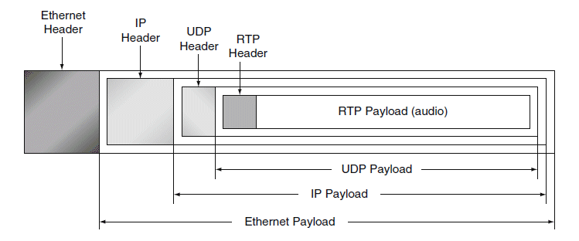
Real-Time Transport Protocol (RTP)
RTP on its own is a push protocol. This means that if a encoder wants to send video
to a decoder using RTP, the encoder would need to know the decoder's IP address
and would push the video to the listening decoder.
prioritize speed over accuracy
reducing latency at the expense of reliability
Time stamps
Controls for synchronizing multiple streams
Sequence numbers (for detecting lost packets)
Payload identification
Beginning and end of frame indications
Intermediate synchronization
ecoder using RTP, the encoder would need to know the decoder's IP address and would push the video to the listening decoder.
<number> / 6

Slide 6
Capturing images
OpenCV library provide may functions that we can use
VideoCapture() function can be used for capturing images from many different sources
    cv::VideoCapture::VideoCapture ( const String & filename,
    int apiPreference = CAP_ANY
    )
name of video file (eg. video.avi)
image sequence (eg. img_%02d.jpg, which will read samples like img_00.jpg, img_01.jpg, img_02.jpg, ...)
URL of video stream (eg. protocol://host:port/script_name?script_params|auth)
GStreamer pipeline string in gst-launch tool format in case if GStreamer is used as backend Note that each video stream or IP camera feed has its own URL scheme. Please refer to the documentation of source stream to know the right URL.
<number> / 6

Slide 7
GStreamer
GStreamer is a pipeline-based multimedia framework that links together a wide variety of media processing systems to complete complex workflows.
https://gstreamer.freedesktop.org/
We use implementation of Gstreamer through jetson-utils package which implement these function on jetson nano
https://github.com/dusty-nv/jetson-inference/blob/master/docs/aux-streaming.md

Slide 8
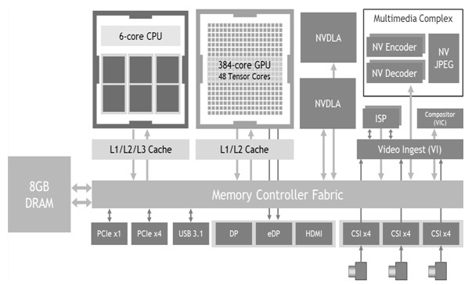
Jetson nano
Jetson support hardware acceleration for video handling
video-viewer csi://0 rtp://@:8554

Slide 9
Receiving the stream
vcap = cv2.VideoCapture("rtsp://10.51.225.51:8554/output")
This will capture the image broadcast by the jetson
His will establish the pointer to the camera ad we can periodically get frames by reading images
ret, frame = vcap.read()

